Slide 1
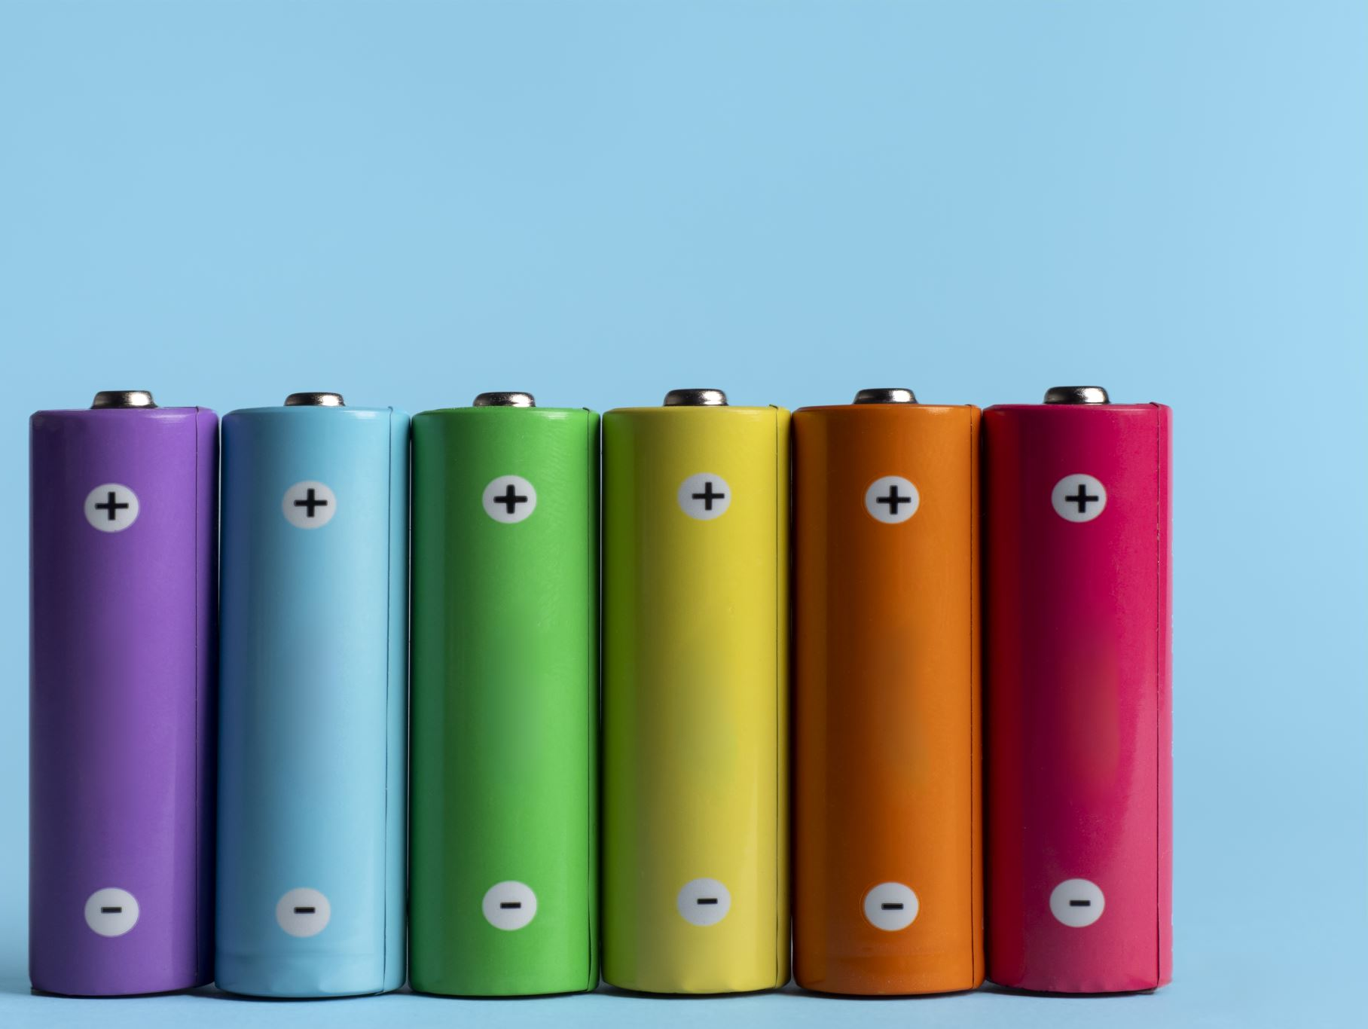
Deep Learning-Based Prediction of Lithium Battery Fire Risk
Utkarsh Satpute (x23135760), Tushar Gharpure (x23289902), Pintoo Baghel (x23287501)

Slide 2
Background & Problem Statement
Increased use of lithium-ion batteries in EVs and portable devices.
Fire risks from thermal runaway, overcharging, mechanical damage.
Need for proactive risk prediction using deep learning.

Slide 3

Objective & Dataset
Objective: Predict if a fire incident involves lithium-ion batteries.
Dataset: Real-world incidents from the London Fire Brigade.
Features include ignition source, power type, vehicle info, etc.

Slide 4
Methodology – CRISP-DM
Structured data mining approach with six phases:
Business Understanding & Data Understanding
Data Preparation (handling missing values, label encoding)
Modeling (ANN with TensorFlow)
Evaluation (accuracy, F1-score, confusion matrix)
Deployment considerations

Slide 5

ANN Model Architecture
Input Layer → Dense (64 neurons, ReLU) → Dropout (30%)
→ Dense (32 neurons, ReLU) → Dropout (20%) → Output (Sigmoid)
Used binary cross-entropy loss and Adam optimizer
Early stopping and dropout layers to prevent overfitting

Slide 6

Results & Visualizations
Accuracy: 84.76%, Precision: 82%, Recall: 81%, F1-Score: 81%
Balanced performance with no major class bias
Confusion matrix and loss/accuracy curves confirm model generalization

Slide 7
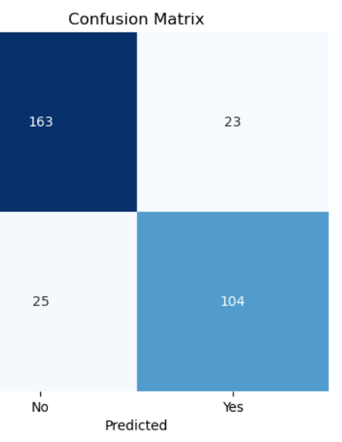
Confusion Matrix – Classification Performance
Shows model predictions vs actual outcomes.
Model correctly identified:
163 non-battery fire incidents (True Negatives)
104 battery-related incidents (True Positives)
Balanced misclassification: 23 false positives, 25 false negatives.
Indicates strong and fair performance across both classes.

Slide 8
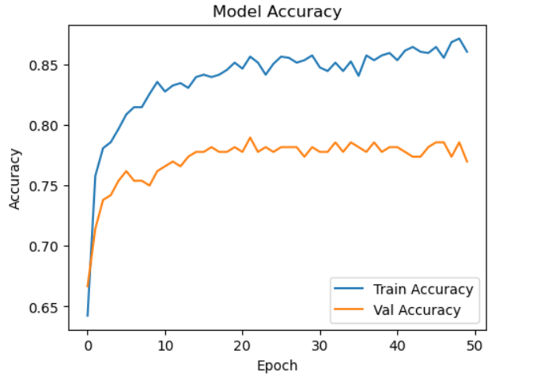
Training vs Validation Accuracy
Shows how model performance improved over 50 epochs.
Training accuracy reached ~87%, validation ~78–80%.
Indicates strong learning and minimal overfitting.

Slide 9
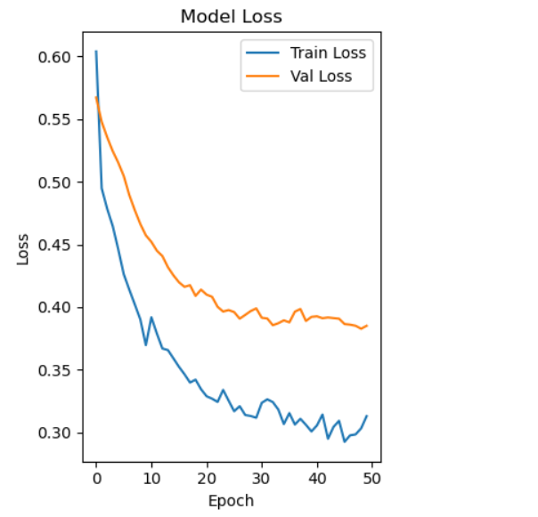
Training vs Validation Loss
Loss curves track how well the model minimized errors.
Training and validation loss decreased steadily.
No signs of overfitting — model learned useful patterns.

Slide 10
Conclusion & Future Work
Effective ANN model for classifying lithium battery fire incidents
Proactive fire risk classification supports early response
Future Work: Add real-time sensor data, SHAP explainability, deploy as dashboard

